Slide 1
GSAC / EPOS 2014
1 Apr 2014, UBI, Covilhã, Portugal
GSAC Overview, part 2.
Stuart Wier
UNAVCO
Notes:
1

Slide 2
GSAC: Java
GSAC uses Java.
The advantages of Java source code are:
- You adapt GSAC for your data repository and for the services you wish to provide. This is necessary since data centers have differing data sources.
- UNAVCO does not maintain multiple compiled versions of GSAC for multiple and changing operating systems (Mac, Windows, Linux, FreeBSD, etc.)
- open source collaborative GSAC development is supported.
The disadvantages of a Java build are:
- GSAC does not work “out of the box”
- you have to build GSAC to install it

Slide 3
GSAC: Development Collaboration
GSAC is open source.
GSAC source code is freely available from SourceForge.
UNAVCO welcomes collaboration in GSAC development.
Today, you can send new GSAC code or improved GSAC code to UNAVCO for testing and incorporation into the GSAC package on the SourceForge repository.
And you can discuss GSAC code with the gsac@unavco.org email list.
In future, UNAVCO may change the GSAC code repository to simplify contributions and development of GSAC code. GSAC may become a true open source development.

Slide 4
GSAC: Installation Overview, 1
Complete installation instructions are in the GSAC package itself. See also the UNAVCO GSAC web site.
You can install GSAC web services for a data repository when you have:
sites (stations, monuments) with instruments
data files from the instruments, or product files from instrumental data, for remote users to download.
a database for GSAC, with complete metadata about sites (stations or monuments), their instruments, and their data files. You can use an existing database you have, or you can make a new database using the GSAC prototype database schema.
a web application server for GSAC. Running GSAC with the Tomcat application server is standard, but Tomcat is optional. GSAC can use its own included application server, Jetty.

Slide 5
GSAC: Installation Overview, 2
an FTP / HTTP download server for the data files.
(GSAC does not download files; GSAC tells users how and where to download files, using a URL for the FTP/HTTP server and the files.)
a Linux system, or UNIX-based system, for build and installation. GSAC is running on Debian, Ubuntu, OpenSUSE, FreeBSD, and MacBook.
with related software tools
bash, a Linux shell
Java JDK 1.6 or 1.7,
subversion ("svn"), a code repository access package
ant, a Java compilation and build tool.
the GSAC software package provided by UNAVCO, on SourceForge. GSAC is free and open source code.

Slide 6
GSAC: Installation Overview, 3
Complete installation instructions are in the GSAC package itself.
To begin, see the UNAVCO GSAC web site, “GSAC Installation” page.
To install GSAC:
Download the GSAC package from SourceForge. Build the GSAC core code (GSAC service layer, or GSL). 2 hours to 1 day.
Either
write new Java code for GSAC to read your existing repository database. approximately 1 to 3 weeks.
Or
create a new database using the GSAC standard or prototype schema, and populate it with metadata about your repository.
approximately 1 to 3 weeks

Slide 7
GSAC: Installation Overview, 4
The GSAC installation
Java coding versus database creation trade-off:
You can use your existing database. Then you write new Java code, using the GSAC classes and methods, to read from your database and to specify what end users can request from GSAC and what data and metadata they can receive. Estimated 2 -3 weeks.
Or, you use some prototype GSAC Java code, and you create a new database with a matching prototype database schema. UNAVCO provides (so far) one set of a matching prototype schema and code.
Estimated 2 – 3 weeks.

Slide 8
A database for GSAC, 1
An essential part of GSAC installation and operations is a database which you provide, about sites (stations or monuments) in your network, about their instruments, and the instrument data files.
The GSAC database contains information about sites which you wish to offer online, and about sites' data files which you wish to offer for download.
The database must contain up-to-date, complete, and correct information if GSAC services are to represent your data repository correctly.
Completely populating your database, and maintaining it, is necessary to operate GSAC, but doing so is outside of GSAC software, and is your responsibility.

Slide 9
A database for GSAC, 2
Which Database System to Use?
GSAC code uses Java JDBC code for SQL queries, which should work with no changes for any of MySQL, Postgres, and Oracle.
The new GSAC development at UNAVCO uses MySQL. MySQL is easy to use and so far has created no problems. The IMO GSAC installation uses MySQL on Debian.
UNAVCO’s GSAC running at UNAVCO uses Oracle.
GSAC code should be able to use Postgres, with no changes to GSAC code, but this is not tested yet.

Slide 10
A database for GSAC, 3
There are two ways to supply a database for GSAC.
You can use an existing database, if your existing database has all the types of station, instrument, and data file metadata required by GSAC.
On the UNAVCO GSAC web site, see the Prototype GSAC database schema notes, and the Prototype's MySQL schema .sql file Prototype_GSAC_Database.sql, to learn about the database fields (columns) required by GSAC to provide its complete suite of web services.
Using your database requires writing Java code, with GSAC class methods, to query the database and to return data information used in results send to the end user.
Or, you can make a new database for GSAC for your data center, using the standard or prototype GSAC database schema provided by UNAVCO, unmodified. In that case the "Prototype" Java files in the GSAC package, PrototypeSiteManager.java and PrototypeFileManager.java, should allow installation of a working GSAC using your database in a few a hours, after your new database is populated.

Slide 11
A database for GSAC, 4
station table:
+--------------------------+-----------------+------+-----+---------+----------------+
| Field | Type | Null | Key | Default | Extra |
+--------------------------+-----------------+------+-----+---------+----------------+
| station_id | int(6) unsigned | NO | PRI | NULL | auto_increment |
| code_4char_ID | char(4) | NO | | NULL | |
| station_name | varchar(50) | NO | | NULL | |
| latitude_north | double | NO | | NULL | |
| longitude_east | double | NO | | NULL | |
| ellipsoidal_height | float | YES | | NULL | |
| station_installed_date | datetime | NO | | NULL | |
| station_removed_date | datetime | YES | | NULL | |
| station_style_id | int(3) unsigned | YES | | NULL | |
| station_status_id | int(3) unsigned | NO | | 1 | |
| access_permission_id | int(3) unsigned | NO | | 2 | |
| monument_description_id | int(5) unsigned | NO | | NULL | |
| country_id | int(5) unsigned | NO | | NULL | |
| province_region_state_id | int(5) unsigned | YES | | NULL | |
| city | varchar(50) | YES | | NULL | |
| x | double | YES | | NULL | |
| y | double | YES | | NULL | |
| z | double | YES | | NULL | |
| iers_domes | varchar(9) | YES | | NULL | |
| station_photo_URL | varchar(100) | YES | | NULL | |
| time_series_image_URL | varchar(100) | YES | | NULL | |
| agency_id | int(3) unsigned | YES | | NULL | |
| networks | varchar(2000) | YES | | NULL | |
| embargo_duration_hours | int(6) unsigned | YES | | NULL | |
| embargo_after_date | datetime | YES | | NULL | |
| nominal_sample_interval | float | YES | | NULL |

Slide 12
A database for GSAC, 5
gnss_data_files table:
+------------------------+------------------+------+-----+---------+----------------+
| Field | Type | Null | Key | Default | Extra |
+------------------------+------------------+------+-----+---------+----------------+
| file_id | int(6) unsigned | NO | PRI | NULL | auto_increment |
| station_id | int(6) unsigned | NO | | NULL | |
| file_type_id | int(3) unsigned | NO | | NULL | |
| file_sample_interval | float | YES | | NULL | |
| data_start_time | datetime | NO | | NULL | |
| data_stop_time | datetime | NO | | NULL | |
| data_year | int(4) unsigned | YES | | NULL | |
| data_day_of_year | int(3) unsigned | YES | | NULL | |
| published_date | datetime | NO | | NULL | |
| revision_time | datetime | YES | | NULL | |
| file_size | int(10) unsigned | YES | | NULL | |
| file_MD5 | char(32) | YES | | NULL | |
| file_url | varchar(120) | YES | | NULL | |
| file_url_protocol | varchar(5) | YES | | NULL | |
| file_url_ip_domain | varchar(120) | YES | | NULL | |
| file_url_folders | varchar(120) | YES | | NULL | |
| file_url_filename | varchar(120) | YES | | NULL | |
| access_permission_id | int(3) unsigned | YES | | NULL | |
| embargo_after_date | datetime | YES | | NULL | |
| embargo_duration_hours | int(6) unsigned | YES | | NULL | |
+------------------------+------------------+------+-----+---------+----------------+

Slide 13
A database for GSAC, 6
receiver_session table:
+------------------------------+-----------------+------+-----+---------+---------------
| Field | Type | Null | Key | Default | Extra
+------------------------------+-----------------+------+-----+---------+---------------
| receiver_session_id | int(5) unsigned | NO | PRI | NULL | auto_increment |
| station_id | int(6) unsigned | NO | | NULL | |
| receiver_type_id | int(5) unsigned | NO | | NULL | |
| receiver_firmware_version_id | int(5) unsigned | NO | | NULL | |
| receiver_serial_number | varchar(20) | NO | | NULL | |
| receiver_installed_date | datetime | NO | | NULL | |
| receiver_removed_date | datetime | YES | | NULL | |
| receiver_sample_interval | float | YES | | NULL | |
| satellite_system | varchar(60) | YES | | NULL | |
+------------------------------+-----------------+------+-----+---------+---------------

Slide 14
A database for GSAC, 7
For complete details about the current prototype GSAC database schema, see the UNAVCO GSAC web site, “GSAC Installation” page.
There is a MySQL .sql file to create a new MySQL database using that schema.
There is a document describing the prototype GSAC database schema.

Slide 15
GSAC Issue 101: How to handle
duplicated Station and File Offerings?
What to do when some GSAC holds data from two or more source GPS networks, some not their own responsibility?
Suggested database new station metadata:
1. Table: station
New Column: station_ownership_id, an id number from:
2. New table station_ownership_value:
Static values or choices allowed:
responsible agency & source GSAC (example NOA1 at NOANet GSAC)
duplicate data sets: do NOT show (example NOA1 at SEGAL GSAC)
designated duplicate: show anyway (example a Spain station at SEGAL)
show all data from this station

Slide 16
GSAC Issue 102:
How to handle multiple file versions?
In gnss_data_files table now:
+------------------------+------------------+-
| Field | Type |
+------------------------+------------------+--
| file_id | int(6) unsigned |
| station_id | int(6) unsigned |
| file_type_id | int(3) unsigned |
…
| data_start_time | datetime |
| data_stop_time | datetime |
…
| published_date | datetime |
Could add new column to station table:

Slide 17
GSAC Issue 102, continued:
How to multiple handle data file versions?
1. Table: station
New Column: file_versions_control_id, an id number from:
2. New table file_versions_control:
Static values or choices allowed:
show only latest published time file
show all versions

Slide 18
GSAC: Installation Instructions, 1
To install GSAC:
Go to the UNAVCO GSAC web site (Google UNAVCO GSAC).
Go to the “GSAC Installation” page
Check section “System requirements”
Check section “Local Repository Implementation Code”
Check section “A Database for GSAC”
Follow section “To Install GSAC.”

Slide 19
GSAC: Installation Instructions, 2
Check System requirements
ant -version
Apache Ant(TM) version 1.8.2 compiled on June 20 2012
java -version
java version "1.6.0_43"
Java(TM) SE Runtime Environment (build 1.6.0_43-b01-447-11M4203)
svn --version
svn, version 1.7.6 (r1370777)
compiled Sep 13 2012, 09:51:20
mysql -u root
Welcome to the MySQL monitor. Commands end with ; or \g.
Your MySQL connection id is 655
Server version: 5.6.17 MySQL Community Server (GPL)

Slide 20
GSAC: Installation Instructions, 3
Begin Installation:
download the GSAC package:
svn export svn://svn.code.sf.net/p/gsac/code/trunk gsac-code
Complete installation instructions are in the GSAC package from SourceForge:
After the svn export, use the README file in
gsac-code/src/org/gsac/

Slide 21
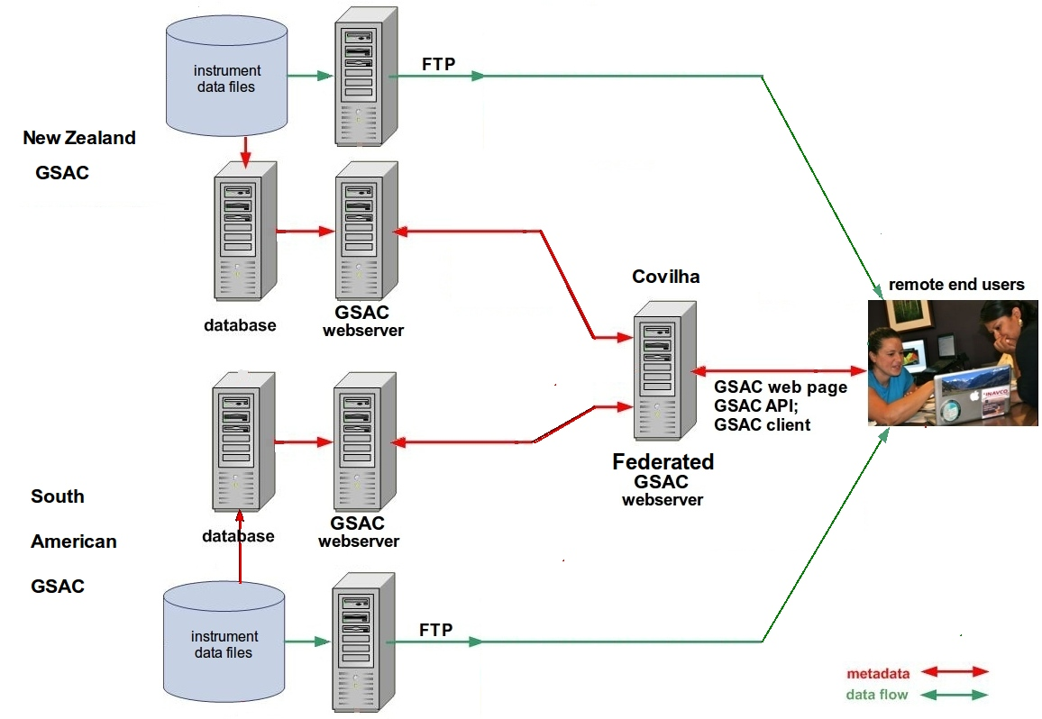
Federated GSAC Servers
Two or more GSAC Repositories can be federated.
A federated GSAC repository is a GSAC Server which effectively merges
or joins services from other GSACs.
The repository implementation uses the web services of the individual repositories for
query/response. It calls the Repository Implementation XML of other GSACs
to learn their services.

Slide 22
Federated GSAC Servers

Slide 23
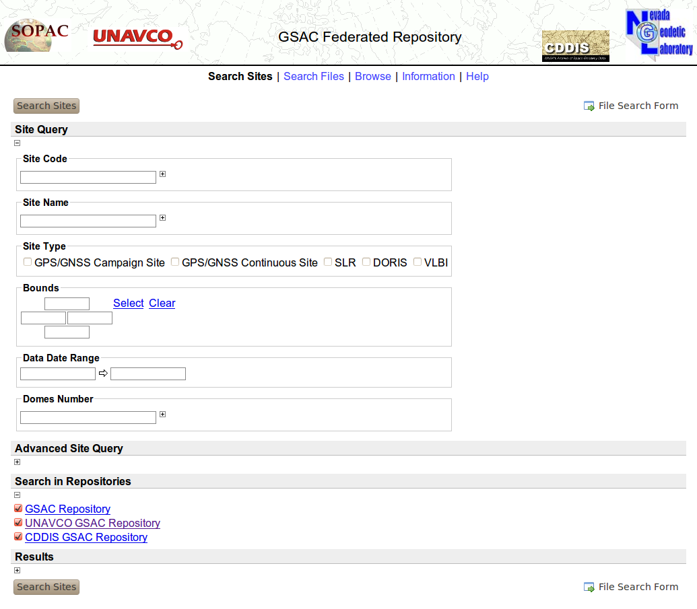
Federated GSAC Servers

Slide 24
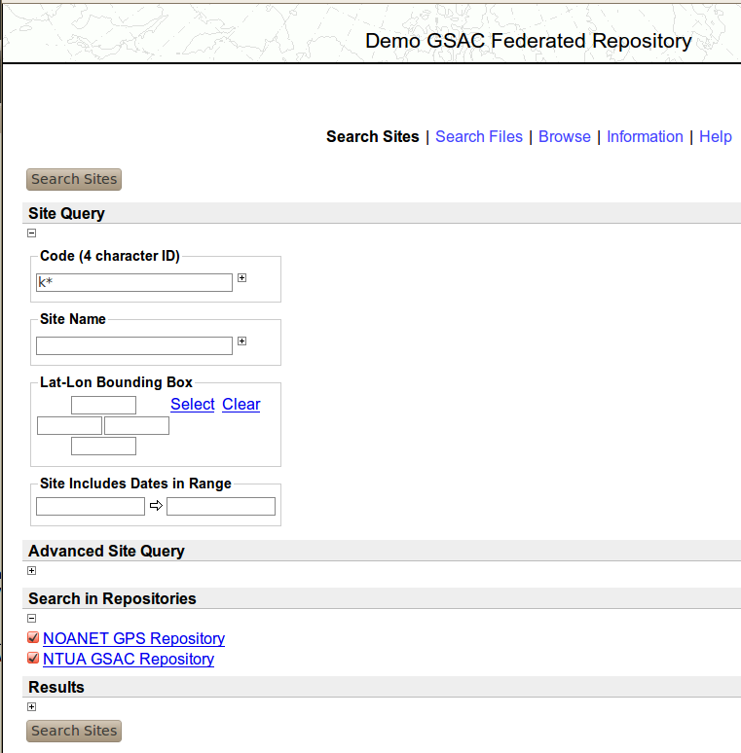
Federated GSAC Servers

Slide 25
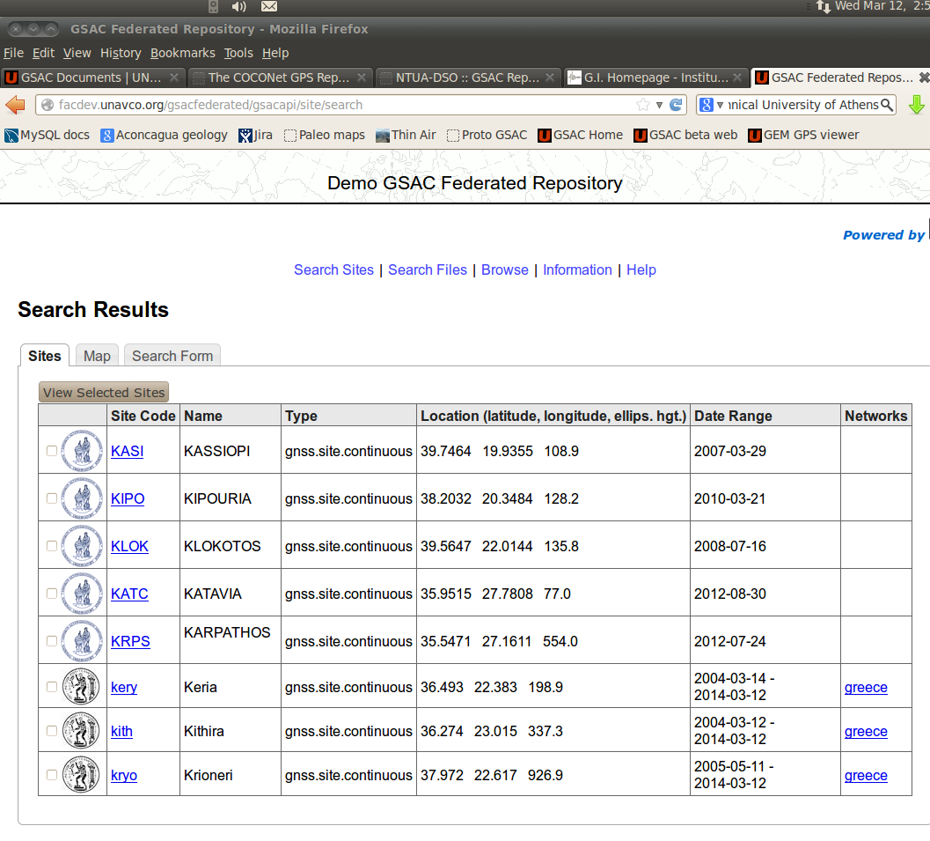
Federated GSAC Servers

Slide 26
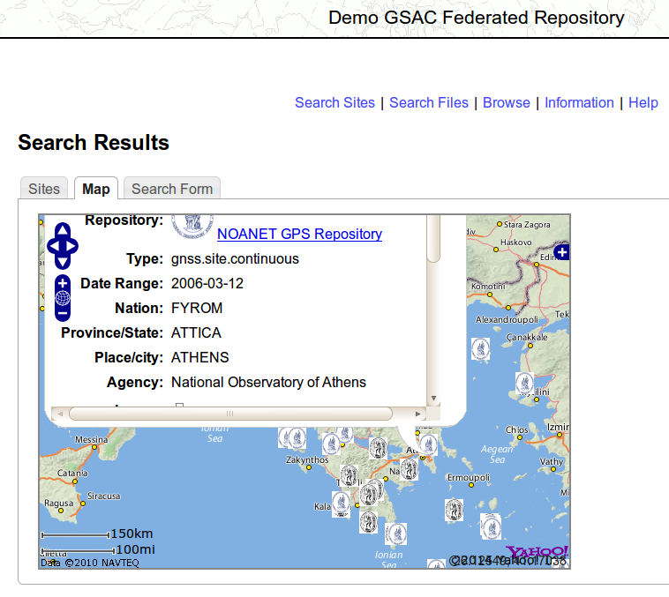
Federated GSAC Servers

Slide 27
Federated GSAC Servers
Installation of a federated GSAC repository is (or should be) easy and fast.
A federated GSAC has no database.
A federated GSAC has no data file repository.
A federated GSAC has no custom Java code.
Installation of federated GSAC code uses:
GSAC core code, and an application server (Tomcat, or Jetty for tests)
GSAC “federated” code in the core code.
One configuration file to specify which remote GSACs to call.
Optional: HTML code for the web page header.
Optional: URLs of logo image files for each remote GSAC.
The repository implementation uses the web services of the individual repositories for query/response.
It calls the Repository Implementation XML of other GSACs to learn their services.

Slide 28
Federated GSAC Servers
This remains to be determined:
How to approve or manage federated collaboration among GSAC servers?
And, is that question even needed?
or,
Do you want anyone anywhere to be able to install a federated GSAC calling on your GSAC services?
A suggested policy to start with: informal, friendly, cooperation.

Slide 29
GSAC: Use Logs
The Apache Tomcat log file (catalina.out) for GSAC has lines like:
GSAC: new request /prototypegsac/gsacapi/site/search?site.code.searchtype=exact&output=site.html&site.code=A*,
time 2014-03-25 11:51:45, from IP 127.0.1.1
GSAC: new request /prototypegsac/gsacapi/site/search?site.code.searchtype=exact&output=site.snx&site.code=A*,
time 2014-03-25 11:51:49, from IP 127.0.1.1
GSAC: new request /prototypegsac/gsacapi/file/search?site.code=aut1&file.datadate.from=2013-01-01 &file.datadate.to
=2013-01-09&file.type=RINEX+observation+file,
time 2014-03-25 11:51:30, from IP 127.0.1.1

Slide 30
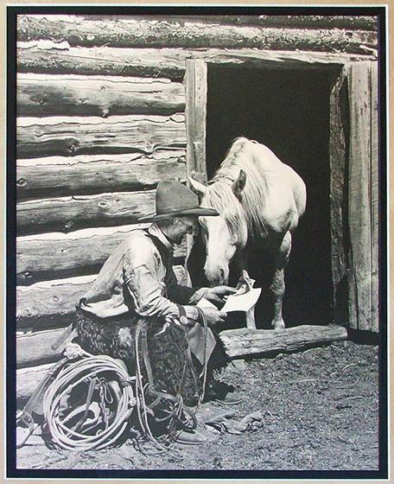
GSAC: Use Demo
To learn how to use GSAC,
Read the book of instructions!
User Guide for GSAC Data Repositories
from the UNAVCO GSAC web site.
Also see the “Help” link on GSAC
server web sites.

Slide 31
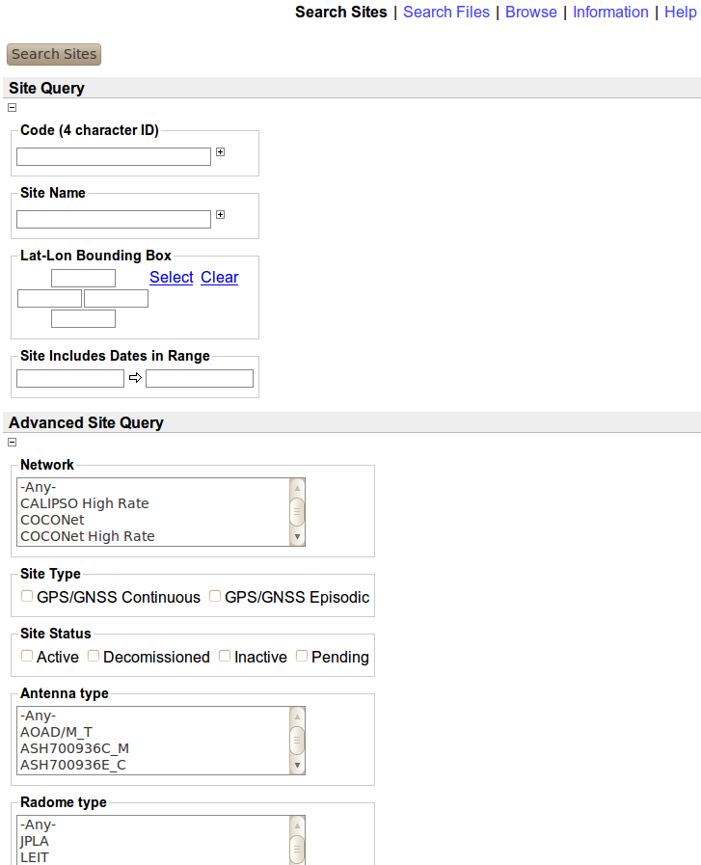
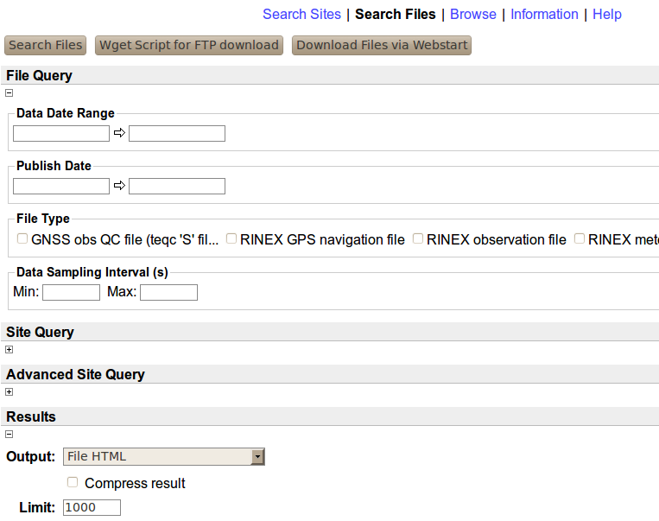
GSAC Use: Web forms

Slide 32
GSAC Use: Site Search Choices
Site Search choices:
code (ID)
station name
latitude - longitude
station installed dates
network name
antenna type
radome type
receiver type
station style (as 'continuous')
station status (as 'active')
country
province / region / state
place name / city
and
all site search result types

Slide 33
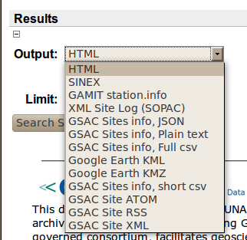
GSAC Use: Site Output Formats
Site Search Output Choices:

Slide 34
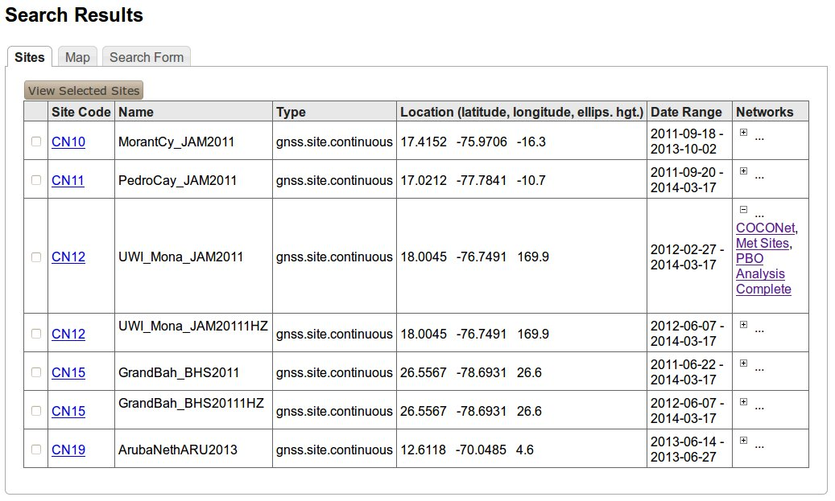
GSAC site search result formats:
HTML Sites Table

Slide 35
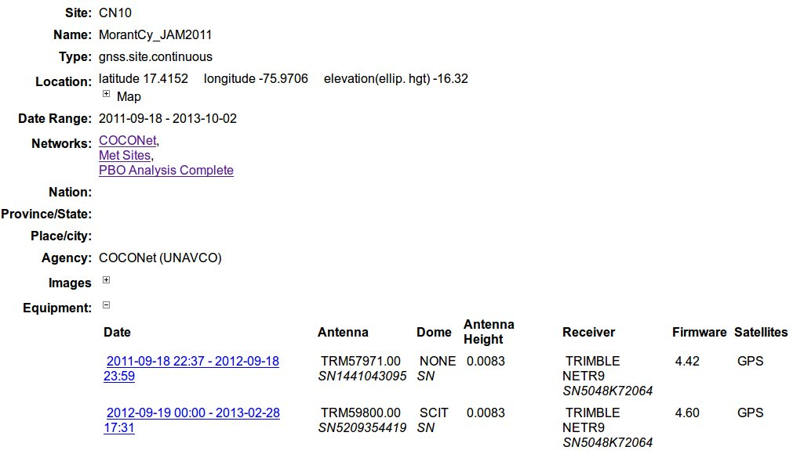
GSAC site search result formats:
HTML single Site page

Slide 36
GSAC site search result formats:
SINEX
%=SNX 2.01 COCONet GSAC Repository 14:076:47520
*-------------------------------------------------------------------------------
+SITE/ID
*CODE PT __DOMES__ T _STATION DESCRIPTION__ APPROX_LON_ APPROX_LAT_ _APP_H_
MCAY A P MCAY -75 58 13.4 17 24 55.8 -17.86
PEDR A P PEDR -77 47 3.5 17 1 15.6 -10.34
-SITE/ID
*-------------------------------------------------------------------------------
+SITE/RECEIVER
*SITE PT SOLN T DATA_START__ DATA_END____ DESCRIPTION_________ S/N__ FIRMWARE___
MCAY A 1 P 07:053:69390 07:061:47880 TRIMBLE 4000SSI 26980 7.19
MCAY A 1 P 10:132:58470 10:140:41730 TRIMBLE 4000SSI 26980 7.19
MCAY A 1 P 12:128:52160 12:128:58392 TRIMBLE NETR9 5145K 4.43
PEDR A 1 P 05:144:53445 05:151:82665 TRIMBLE 4000SSI 26980 7.19
PEDR A 1 P 07:149:47790 07:156:48210 TRIMBLE 4000SSI 26980 7.19
PEDR A 1 P 09:251:43260 09:258:77040 TRIMBLE 4000SSI 26980 7.19
PEDR A 1 P 12:080:44961 12:080:50269 TRIMBLE NETR9 5145K 4.43
-SITE/RECEIVER
*-------------------------------------------------------------------------------
+SITE/ANTENNA
*SITE PT SOLN T DATA_START__ DATA_END____ DESCRIPTION_________ S/N__
MCAY A 1 P 07:053:69390 07:061:47880 TRM29659.00 17520
MCAY A 1 P 10:132:58470 10:140:41730 TRM41249.00 -----
MCAY A 1 P 12:128:52160 12:128:58392 TRM39105.00 11909
PEDR A 1 P 05:144:53445 05:151:82665 TRM29659.00 17520
PEDR A 1 P 07:149:47790 07:156:48210 TRM29659.00 17520
PEDR A 1 P 09:251:43260 09:258:77040 TRM29659.00 17520
PEDR A 1 P 12:080:44961 12:080:50269 TRM39105.00 11909
-SITE/ANTENNA
*-------------------------------------------------------------------------------
+SITE/ECCENTRICITY
* UP______ NORTH___ EAST____
*SITE PT SOLN T DATA_START__ DATA_END____ AXE ARP->BENCHMARK(M)_________
MCAY A 1 P 07:053:69390 07:061:47880 UNE 0.5500 0.0000 0.0000
MCAY A 1 P 10:132:58470 10:140:41730 UNE 0.5500 0.0000 0.0000

Slide 37
GSAC site search result formats:
GAMIT station.info
* Gamit station.info
*
* Generated by the COCONet GSAC Repository at 2014-03-17T13:16:58 -0600
*
*SITE Station Name Session Start Session Stop Ant Ht HtCod Ant N Ant E Receiver Type Vers SwVer Receiver SN Antenna Type Dome Antenna SN
MCAY MCAY 2007 53 19 16 30 2007 61 13 18 00 0.55 ----- 0.0000 0.0000 TRIMBLE 4000SSI 7.19 7.19 26980 TRM29659.00 ----- 175206
MCAY MCAY 2010 132 16 14 30 2010 140 11 35 30 0.55 ----- 0.0000 0.0000 TRIMBLE 4000SSI 7.19 7.19 26980 TRM41249.00 ----- --------------------
MCAY MCAY 2012 128 14 29 20 2012 128 16 13 12 0.018 ----- 0.0000 0.0000 TRIMBLE NETR9 4.43 4.43 5145K79600 TRM39105.00 ----- 11909599
PEDR PEDR 2005 144 14 50 45 2005 151 22 57 45 0.55 ----- 0.0000 0.0000 TRIMBLE 4000SSI 7.19 7.19 26980 TRM29659.00 ----- 175206
PEDR PEDR 2007 149 13 16 30 2007 156 13 23 30 0.55 ----- 0.0000 0.0000 TRIMBLE 4000SSI 7.19 7.19 26980 TRM29659.00 ----- 175206
PEDR PEDR 2009 251 12 01 00 2009 258 21 24 00 0.55 ----- 0.0000 0.0000 TRIMBLE 4000SSI 7.19 7.19 26980 TRM29659.00 ----- 175206

Slide 38
GSAC site search result formats:
SOPAC XML Site Log
<igsSiteLog xsi:schemaLocation="http://sopac.ucsd.edu/ns/geodesy/doc/igsSiteLog/2011 http://sopac.ucsd.edu/ns/geodesy/doc/igsSiteLog/2011/igsSiteLog.xsd"><formInformation><mi:preparedBy>COCONet GSAC Repository</mi:preparedBy><mi:datePrepared>2014-03-17T13:23:09</mi:datePrepared><mi:reportType>DYNAMIC</mi:reportType></formInformation><siteIdentification><mi:siteName>MCAY</mi:siteName><mi:fourCharacterID>MCAY</mi:fourCharacterID><mi:dateInstalled>2007-02-22T00:00:00</mi:dateInstalled>
<mi:monumentInscription/><mi:iersDOMESNumber/><mi:cdpNumber/><mi:monumentDescription/><mi:heightOfTheMonument/><mi:monumentFoundation/><mi:foundationDepth/><mi:markerDescription/><mi:geologicCharacteristic/><mi:bedrockType/><mi:bedrockCondition/><mi:fractureSpacing/><mi:faultZonesNearby/><mi:distance-Activity/><mi:notes/></siteIdentification>
<siteLocation><mi:country/><mi:state/><mi:city/><mi:approximatePositionITRF><mi:latitude-North>17.4155</mi:latitude-North><mi:longitude-East>-75.9704</mi:longitude-East><mi:elevation-m_ellips>0</mi:elevation-m_ellips></mi:approximatePositionITRF></siteLocation>
<gnssReceiver><equip:receiverType>TRIMBLE 4000SSI </equip:receiverType><equip:serialNumber>26980</equip:serialNumber><equip:firmwareVersion>7.19 </equip:firmwareVersion><equip:dateInstalled>2007-02-22T19:16:30</equip:dateInstalled><equip:dateRemoved>2007-03-02T13:18:00</equip:dateRemoved><equip:satelliteSystem>GPS</equip:satelliteSystem><equip:elevationCutoffSetting/><equip:temperatureStabilization/><equip:notes/></gnssReceiver>
<gnssAntenna><equip:antennaType>TRM29659.00 </equip:antennaType><equip:serialNumber>175206</equip:serialNumber><equip:marker-arpUpEcc.>0.55</equip:marker-arpUpEcc.><equip:marker-arpNorthEcc.>0</equip:marker-arpNorthEcc.><equip:marker-arpEastEcc.>0</equip:marker-arpEastEcc.><equip:alignmentFromTrueNorth/><equip:antennaRadomeType> </equip:antennaRadomeType><equip:radomeSerialNumber> </equip:radomeSerialNumber><equip:antennaCableType/><equip:antennaCableLength/><equip:dateInstalled>2007-02-22T19:16:30</equip:dateInstalled><equip:dateRemoved>2007-03 02T13:18:00</equip:dateRemoved>
...

Slide 39
GSAC site result formats:
GSAC JSON site information
[{"Id":"MCAY","Type":{"Id":"gnss.site.episodic","Label":
"gnss.site.episodic"},"ShortName":"MCAY","LongName":"MCAY","Metadata":[
{"Label":"politicallocation","ForDisplay":true},{"Type":"property",
"Label":"Agency","ForDisplay":true},{"Label":"Images","ForDisplay":
true}],"MetadataLevel":0,"ResourceGroups":[{"Id":
"COCONet Jamaica Cays 2012","Label":"COCONet Jamaica Cays 2012"}],
"RelatedResources":[],"EarthLocation":{"Latitude":17.4155,"Longitude":
-75.9704,"Elevation":-17.86,"X":NaN,"Y":NaN,"Z":NaN},"FromDate":
"Feb 22, 2007","ToDate":"May 7, 2012","SampleInterval":0.0},{"Id":
"PEDR","Type":{"Id":"gnss.site.episodic","Label":"gnss.site.episodic"},
"ShortName":"PEDR","LongName":"PEDR","Metadata":[{"Label":
"politicallocation","ForDisplay":true},{"Type":"property","Label":
"Agency","ForDisplay":true},{"Label":"Images","ForDisplay":true}],
"MetadataLevel":0,"ResourceGroups":[{"Id":"COCONet Jamaica Cays 2012",
"Label":"COCONet Jamaica Cays 2012"}],"RelatedResources":[],
"EarthLocation":{"Latitude":17.021,"Longitude":-77.7843,"Elevation":
-10.34,"X":NaN,"Y":NaN,"Z":NaN},"FromDate":"May 24, 2005","ToDate":
"Mar 20, 2012","SampleInterval":0.0}

Slide 40
GSAC site result formats:
GSAC Plain Text
GSAC data respository: site information in plain text for visual inspection.
Generated by the COCONet GSAC Repository on 2014-03-17 13:30:45
Empty times (no characters) may mean 'not removed' or 'no change.'
This format may change without notice. Not intended for computer processing.
site 1 (in this list):
site four char ID: MCAY
site place name: MCAY
site continuous or campaign: gnss.site.episodic
site agency: COCONet (UNAVCO)
site IERSDOMES:
site installed date: 2007-02-22 00:00:00
site removed date: 2012-05-07 00:00:00
site monument description:
site frequency standard:
site cdp number:
site country:
site state or province:
site city/place:
site latitude: 17.4155
site longitude: -75.9704
site TRF or Datum name:
site ellipsoid height: -17.86
site ellipsoid name:
site X coordinate:
site Y coordinate:
site Z coordinate:
site elevation: (height above geoid model)
geoid model name:
Receiver info; equipment session 1
receiver type: TRIMBLE 4000SSI
receiver SN: 26980
receiver firmware vers: 7.19
receiver firmware SwVer: 7.19
receiver sample intervl:0.0
receiver installed date:2007-02-22 19:16:30
receiver removed date: 2007-03-02 13:18:00
Antenna info; equipment session 1
antenna type: TRM29659.00
antenna SN: 175206
antenna offset Ht (up): 0.55

Slide 41
GSAC site result formats:
GSAC full comma-separated value
#fields=ID[type='string'],station name[type='string'],latitude,longitude,ellip. height[unit='m'],monument description[type='string'],IERSDOMES[type='string'],start time[type='date' format='yyyy-MM-ddTHH:mm:ss zzzzz'],stop time[type='date' format='yyyy-MM-ddTHH:mm:ss zzzzz'],antenna type[type='string'],dome type[type='string'],antenna SN[type='string'],Ant dZ,Ant dN,Ant dE,receiver type[type='string'], firmware version[type='string'], receiver SN[type='string'],sample interval,SwVer,site count
# Generated by COCONet GSAC Repository on 2014-03-17 13:34:33
# Missing times (no characters) may mean 'not removed' or 'no change.'
MCAY,MCAY,17.4155,-75.9704,-17.86,,,2007-02-22 19:16:30,2007-03-02 13:18:00,TRM29659.00 , , 175206,0.55,0.0000,0.0000,TRIMBLE 4000SSI ,7.19 ,26980,0.0, 7.19,1
MCAY,MCAY,17.4155,-75.9704,-17.86,,,2010-05-12 16:14:30,2010-05-20 11:35:30,TRM41249.00 , ,N/A,0.55,0.0000,0.0000,TRIMBLE 4000SSI ,7.19 ,26980,0.0, 7.19,1
MCAY,MCAY,17.4155,-75.9704,-17.86,,,2012-05-07 14:29:20,2012-05-07 16:13:12,TRM39105.00 , ,11909599,0.018,0.0000,0.0000,TRIMBLE NETR9 ,4.43 ,5145K79600,0.0, 4.43,1
PEDR,PEDR,17.021,-77.7843,-10.34,,,2005-05-24 14:50:45,2005-05-31 22:57:45,TRM29659.00 , ,175206,0.55,0.0000,0.0000,TRIMBLE 4000SSI ,7.19 ,26980,0.0, 7.19,2
PEDR,PEDR,17.021,-77.7843,-10.34,,,2007-05-29 13:16:30,2007-06-05 13:23:30,TRM29659.00 , ,175206,0.55,0.0000,0.0000,TRIMBLE 4000SSI ,7.19 ,26980,0.0, 7.19,2
PEDR,PEDR,17.021,-77.7843,-10.34,,,2009-09-08 12:01:00,2009-09-15 21:24:00,TRM29659.00 , ,175206,0.55,0.0000,0.0000,TRIMBLE 4000SSI ,7.19 ,26980,0.0, 7.19,2
PEDR,PEDR,17.021,-77.7843,-10.34,,,2012-03-20 12:29:21,2012-03-20 13:57:49,TRM39105.00 , ,11909599,0.018,0.0000,0.0000,TRIMBLE NETR9 ,4.43 ,5145K79600,0.0, 4.43,2

Slide 42
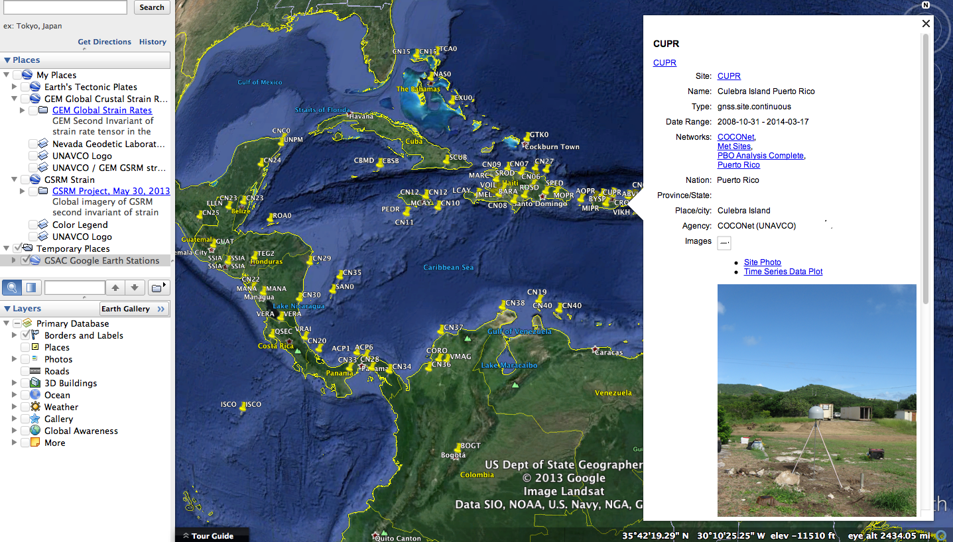
GSAC site result formats:
Google Earth KMZ and KML

Slide 43
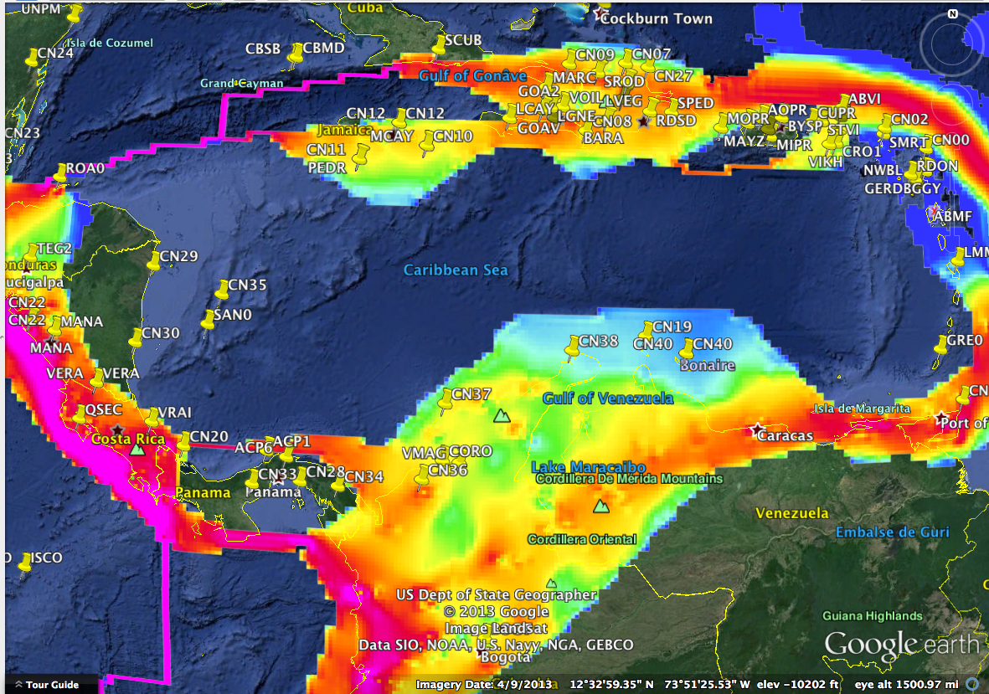
GSAC site results in
Google Earth KMZ and KML

Slide 44
GSAC Use: File Search Choices
File Search choices:
Date or date range
'published' date range
file type (as RINEX obs file)
data sampling interval (as 15 s)
and
all site choices
and
all file search result types

Slide 45
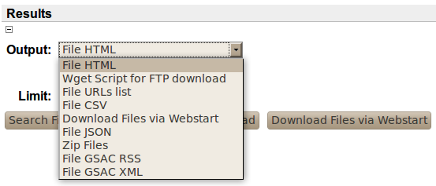
GSAC Use: File Output Formats
File Search Output choices:

Slide 46
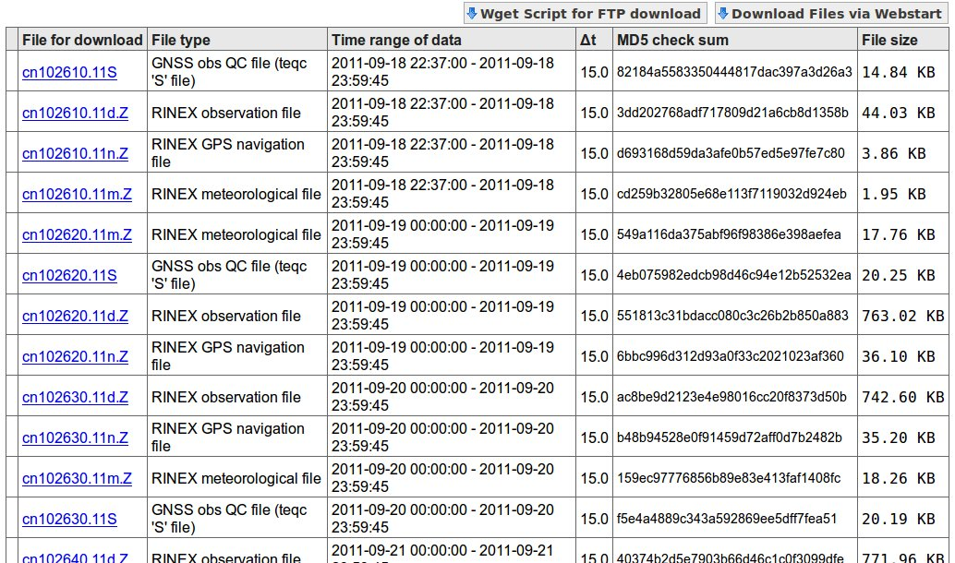
GSAC file search result formats:
File table (HTML)

Slide 47
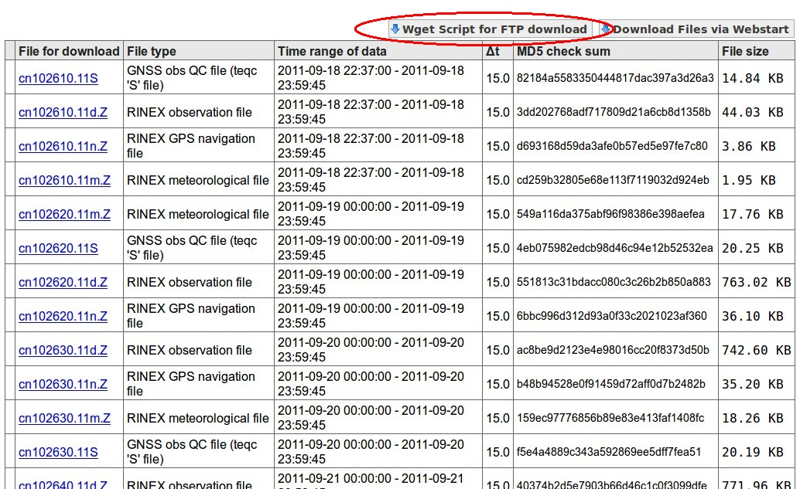
GSAC file search result formats:
File table –> wget script access

Slide 48
GSAC file search result formats:
URLs of data files to download
http://egelados.gein.noa.gr/services/GPS/GPS_DATA/2013/001/orid1430.13d.Z
http://egelados.gein.noa.gr/services/GPS/GPS_DATA/2013/001/orid1430.13n.Z
http://egelados.gein.noa.gr/services/GPS/GPS_DATA/2013/002/orid0020.13n.Z
http://egelados.gein.noa.gr/services/GPS/GPS_DATA/2013/002/orid0020.13d.Z
http://egelados.gein.noa.gr/services/GPS/GPS_DATA/2013/003/orid0030.13n.Z
http://egelados.gein.noa.gr/services/GPS/GPS_DATA/2013/003/orid0030.13d.Z
http://egelados.gein.noa.gr/services/GPS/GPS_DATA/2013/004/orid0040.13d.Z
http://egelados.gein.noa.gr/services/GPS/GPS_DATA/2013/004/orid0040.13n.Z
http://egelados.gein.noa.gr/services/GPS/GPS_DATA/2013/005/orid0050.13d.Z
http://egelados.gein.noa.gr/services/GPS/GPS_DATA/2013/005/orid0050.13n.Z
http://egelados.gein.noa.gr/services/GPS/GPS_DATA/2013/006/orid0060.13n.Z
http://egelados.gein.noa.gr/services/GPS/GPS_DATA/2013/006/orid0060.13d.Z
http://egelados.gein.noa.gr/services/GPS/GPS_DATA/2013/007/orid0070.13n.Z

Slide 49
GSAC file search result formats:
wget script
wget ftp://www.crs.inogs.it/pub/gps/rinex/2014/053/suse0530.14s.Z
wget ftp://www.crs.inogs.it/pub/gps/rinex/2014/054/suse0540.14n.Z
wget ftp://www.crs.inogs.it/pub/gps/rinex/2014/054/suse0540.14s.Z
wget ftp://www.crs.inogs.it/pub/gps/rinex/2014/054/suse0540.14d.Z
wget ftp://www.crs.inogs.it/pub/gps/rinex/2014/055/suse0550.14d.Z
wget ftp://www.crs.inogs.it/pub/gps/rinex/2014/055/suse0550.14n.Z
wget ftp://www.crs.inogs.it/pub/gps/rinex/2014/055/suse0550.14s.Z
wget ftp://www.crs.inogs.it/pub/gps/rinex/2014/056/suse0560.14d.Z
wget ftp://www.crs.inogs.it/pub/gps/rinex/2014/056/suse0560.14n.Z
wget ftp://www.crs.inogs.it/pub/gps/rinex/2014/056/suse0560.14s.Z
wget ftp://www.crs.inogs.it/pub/gps/rinex/2014/057/suse0570.14s.Z
wget ftp://www.crs.inogs.it/pub/gps/rinex/2014/057/suse0570.14d.Z
wget ftp://www.crs.inogs.it/pub/gps/rinex/2014/057/suse0570.14n.Z
wget ftp://www.crs.inogs.it/pub/gps/rinex/2014/058/suse0580.14d.Z
wget ftp://www.crs.inogs.it/pub/gps/rinex/2014/058/suse0580.14n.Z
wget ftp://www.crs.inogs.it/pub/gps/rinex/2014/058/suse0580.14s.Z
wget ftp://www.crs.inogs.it/pub/gps/rinex/2014/059/suse0590.14s.Z
...

Slide 50
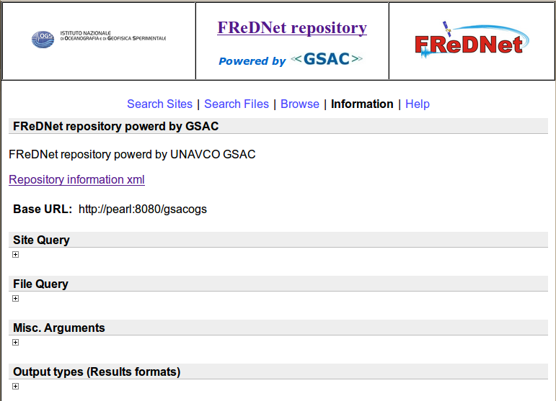
GSAC Use: Information Page
Every GSAC server has a page of Information:

Slide 51
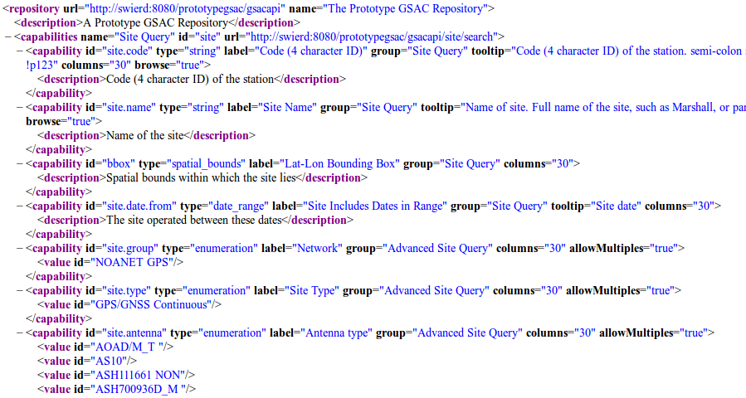
GSAC Use: Information Page, 2
The Information page has
Repository information XML:

Slide 52
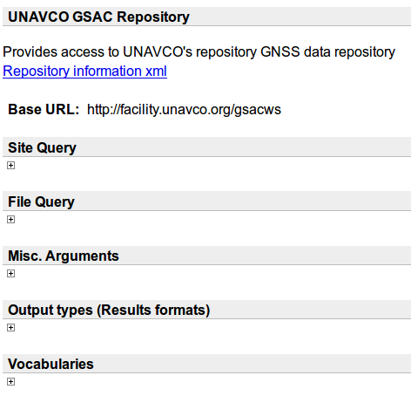
GSAC Use: Information Page, 3
The Information page has
Base URL: http://facility.unavco.org/gsacws

Slide 53
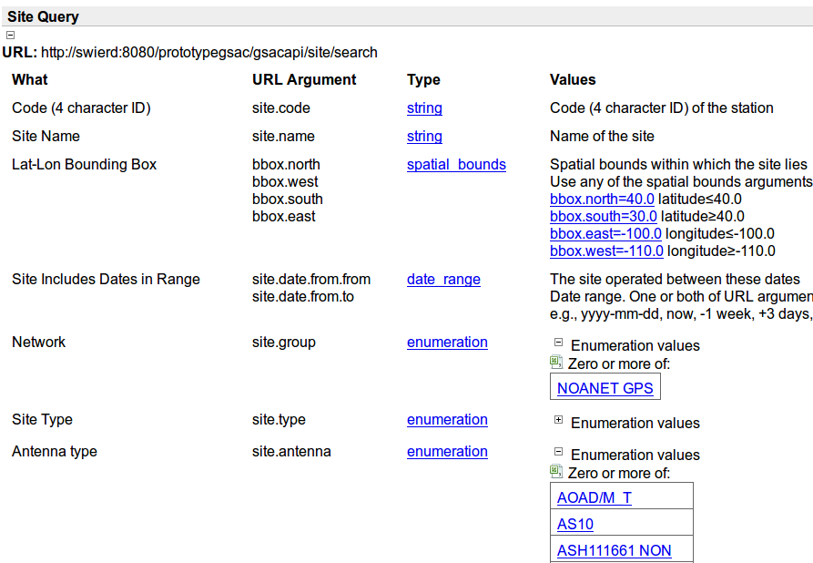
GSAC Use: Information Page, 4
The Information page has Site query API arguments:

Slide 54
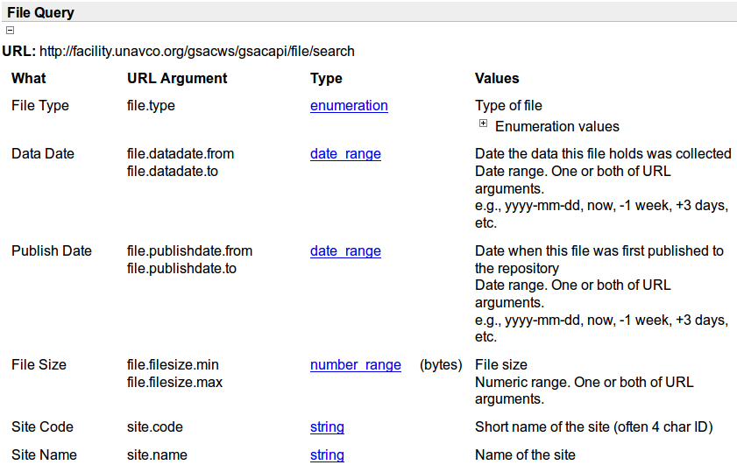
GSAC Use: Information Page, 5
The Information page has File query API arguments:

Slide 55
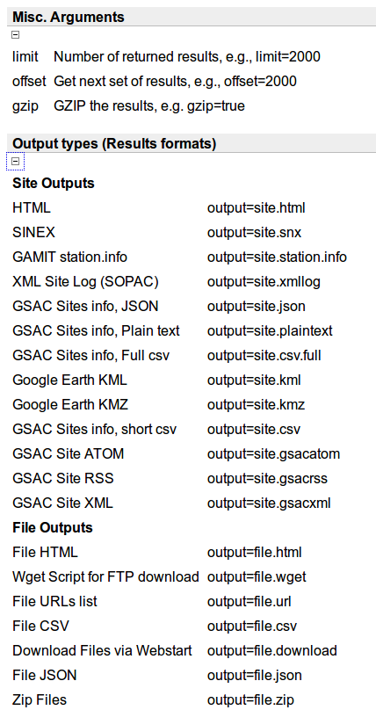
GSAC Use: Information Page, 6
The Information page has
Output Types (Results Formats) API arguments:

Slide 56
GSAC Use: the API
GSAC has a complete RESTful API (application interface). You compose a URL to do queries and choose a format for the results, without using the GSAC UI web page forms. This allows programmatic (computer) queries.
http://facility.unavco.org/gsacws/gsacapi/site/search?site.code=P210
http://facility.unavco.org/gsacws/gsacapi/site/search?site.code=P210&output=site.snx
http://facility.unavco.org/gsacws/gsacapi/file/search?site.group=COCONet&output=
file.csv&file.datadate.from=2013-11-01&file.datadate.to=2014-01-31& site.interval=interval.normal&limit=100 >
coconet_2013Nov-2014Jan_file_metadata.csv
With the Linux “curl” utility:
> curl “http://facility.unavco.org/gsacws/gsacapi/site/search?site.code=P210“
you can run all GSAC requests from a command line, or in a script, with no browser.
See the User Guide for GSAC Geoscience Data Repositories on the UNAVCO GSAC website for complete details.

Slide 57
GSAC Use: the client program
There is a GSAC client program (gsacclient.jar) for programmatic searches of a GSAC repository and to download files. The GSAC client is available as part of the GSAC package.
This program is an alternative on Windows for the use of 'curl' commands on Linux.
The client may be run on Linux also.
On a command line:
> gsacclient.sh -server http://facility.unavco.org/gsacws
-site.code P120
> gsacclient.sh -server http://facility.unavco.org/gsacws
-site.code P120 -output site.snx
> gsacclient.sh -file site.code p123 -file.datadate.from 2010-09-01 -file.datadate.to 2010-09-15 -output file.url
See the User Guide for GSAC Geoscience Data Repositories on the UNAVCO GSAC website for complete details.

Slide 58
GSAC: the GSAC email discussion list
The GSAC email discussion group is for operators of GSAC, for exchange of news about GSAC and for suggestions and discussions of ideas about GSAC.
For how to join, see the web page
http://postal.unavco.org/mailman/listinfo/gsac

Slide 59
.
Email about GSAC to:
Fran Boler, UNAVCO, boler@unavco.org
Stuart Wier, UNAVCO, wier@unavco.org

